Slide 1
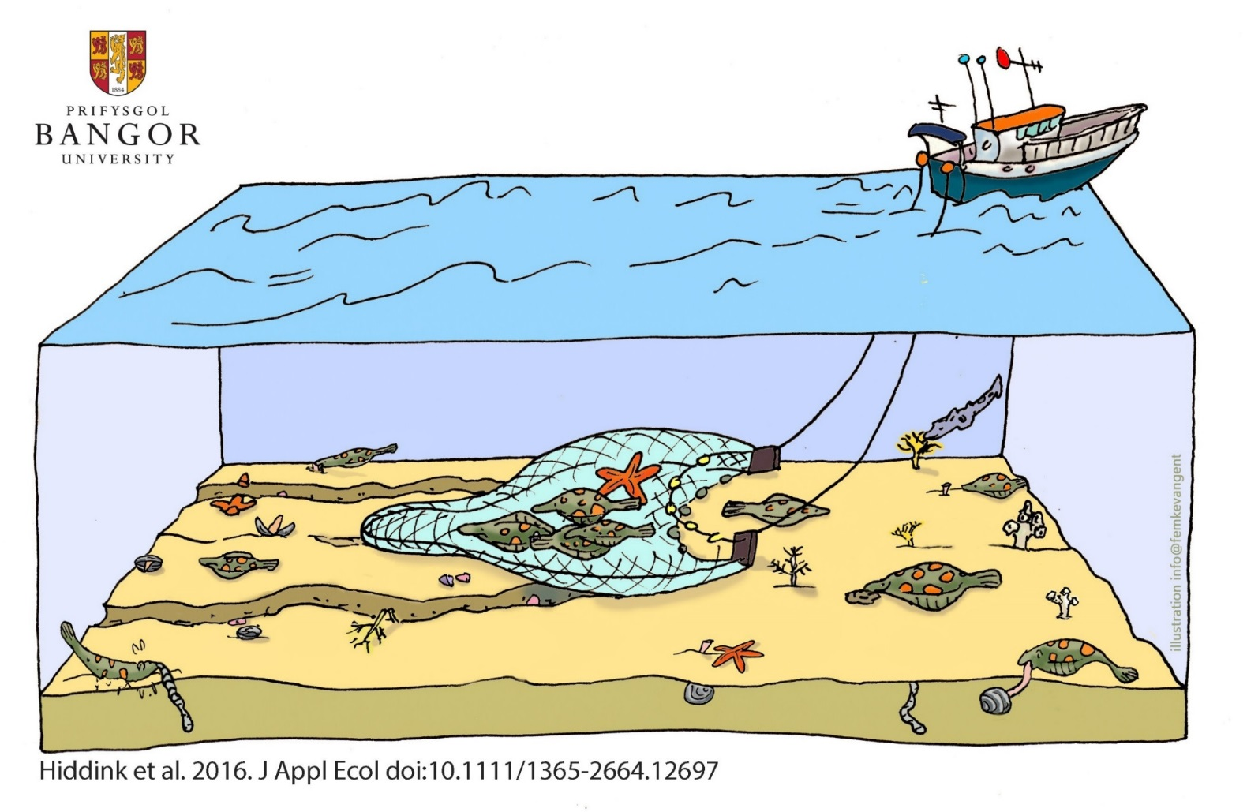

Assessing bottom-trawling impacts: A quantitative approach
Prof Jan Geert Hiddink
@Macomabalthica
Dr Jenny Shepperson
@jennyshepperson
Dr Lowri E Evans
@L0wriEvans
Primary contact: lowri.evans@bangor.ac.uk or
call: 01248 383279
Notes:
Good afternoon, I’m Lowri and I’ve been working at Bangor University with Jan Hiddink since December. During this talk, I will summarise a model-based quantitative approach to assessing bottom trawling impacts.

Slide 2
But first… What is a model?
Notes:
But first, what is a model?

Slide 3
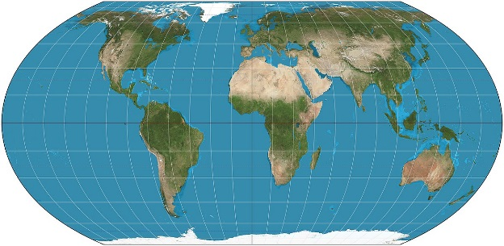

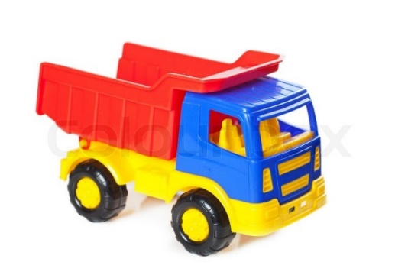
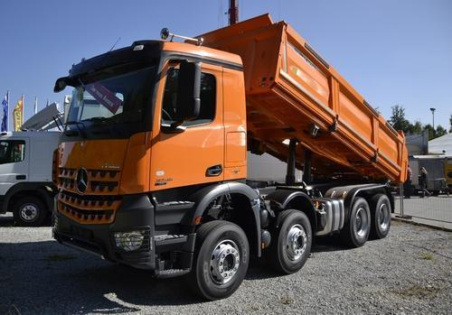
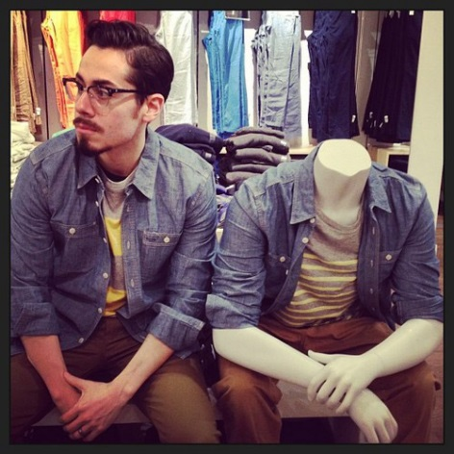
We use models every day!
Thing of interest…
Structured model
Notes:
A model is a structure based on the one you are interested in: a map represents the earth, a toy truck is a characterization of a real truck, and a store mannequin or human 'model' is supposed to show how clothes look like on a customer's body. So we use modeling informally all the time.

Slide 4
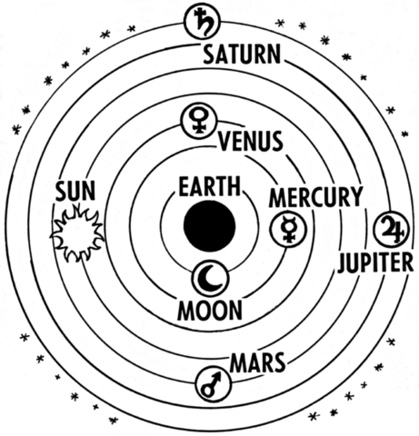
A simplified description of a system or process, to assist calculations and predictions…
Summarise
Organise
Synthesise
Knowledge
Predict
The first models were used to predict motion of planets and stars…
Notes:
A model is a simplified description of a system or process, typically mathematical, to assist in calculations and predictions. The first models were developed to predict the motion of planets and stars…

Slide 5


Models come in varying degrees of complexity…
Notes:
It could be of varying levels of descriptive detail like sketches of a flower in an artist's notebook.

Slide 6
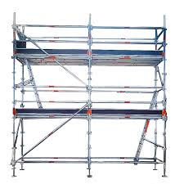
Equation-based
Population dynamics of benthic habitat
Model -> mathematical model -> ecological model -> population model
Ecological variables
Notes:
So, within this project, the model we are dealing with is an equation, which uses ecological variables and others to determine the population dynamics of the benthic habitat.

Slide 7
Relative Benthic Status (RBS) model
What is the purpose of this model?
To UNDERSTAND and MANAGE impacts of fishing on the benthic community in a quantitative way
Notes:
The model that we’re using is called the Relative Benthic Status or RBS in short. This is where the first question comes in from the last workshop. Questions from the last workshop are highlighted with yellow stars throughout the talk, so keep your eyes peeled for your question if you asked one. What is the purpose of the model? Simply, the purpose is to understand and manage impacts of fishing on the benthic community in a quantitative way.

Slide 8
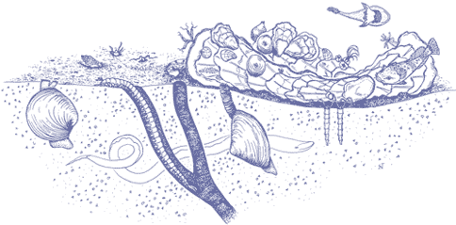
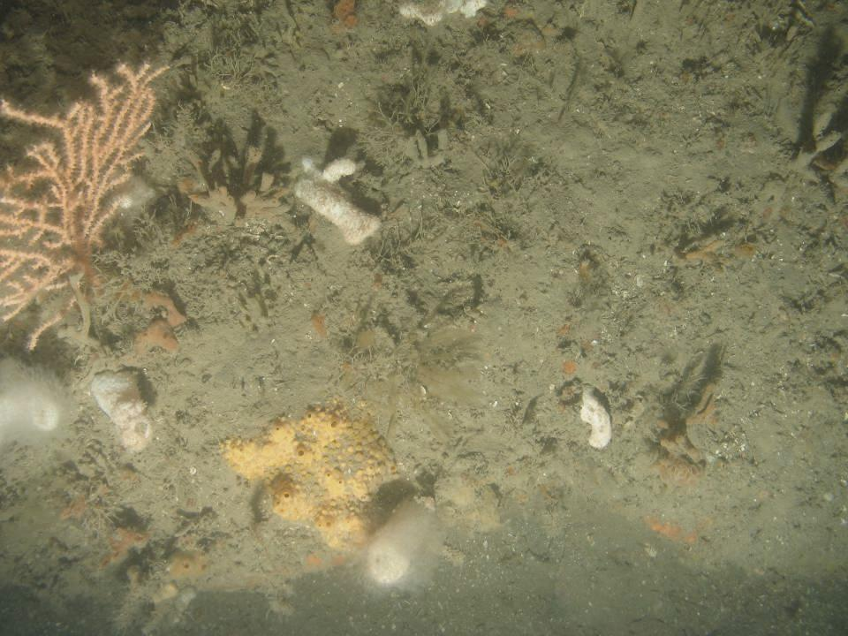
Benthic community:
animals living in and on the sea bottom
Food for fish, sea birds, marine mammals
Bioturbation: nutrient regeneration
EU directives
Notes:
This model relates to the benthic community – so that is animals living in and on the seabed. These communities are important food for a range of animals, and perform ecological functions, so consequently, we need to ensure that we manage and conserve these communities in an appropriate way.

Slide 9
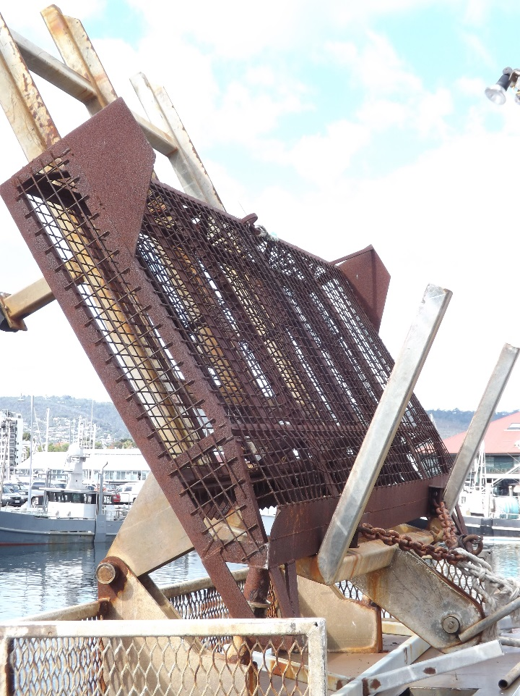
Physical disturbance of seabed sediments by bottom trawls,
by design
Beam trawl / otter trawl / scallop dredge
Impact on benthos
Abundance
Biomass
Production
Species richness
Notes:
When we fish using bottom trawls, we risk damaging these benthic communities. By design, bottom trawls make contact with the seabed, causing physical disturbance and damage. By bottom trawls, we are referring to beam trawls, otter trawls, and scallop dredges. And these gears can have an impact on the benthos, reducing abundance, biomass, production and species richness.

Slide 10
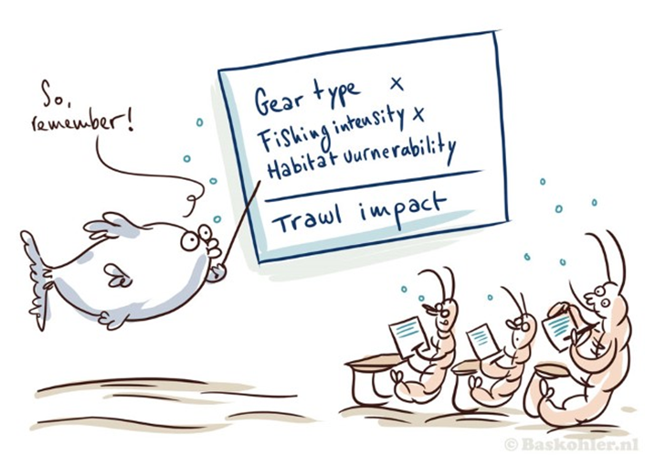
Three steps to quantify impacts
Map fishing activities & habitats
Quantify effects per gear and habitat
Assessment
Notes:
To understand, and to manage the impacts of fishing on the benthic community, ideally we need to be able to quantify these impacts. There are 3 steps to doing this – we need to know where fishing takes place, and over what habitats, we need to quantify the effects of each gear type in each habitat, and we need to have an assessment methodology that combines these pieces of information to quantify the impacts at a certain scale.
If we know where fishing takes place, over what habitats, and we can quantify the impact of that type of fishing on that type of habitat, then we can quantify the impact of trawling in that area.
In this talk I’m going to tell you about how Jan Hiddink and colleagues have addressed this second point – quantifying the effect of different trawl gears, and then tell you about the ..

Slide 11

Relative Benthic Status – building the model
(Comment: More of an overview about what studies the model is based on)
RBS $=1 − \frac{Fishing Effort ×Depletion Rate}{Recovery Rate}$
Pitcher et al., (2017) (paper 1)
Notes:
So now, we’ll start building the Relative Benthic Status model together. Another query from the last workshop was about the studies the model is based on, so from now on, the studies are highlighted with red stars, so again keep your eyes peeled for those. Below is the first study, where Pitcher et al propose the Relative Benthic status model. The model basically involves the relationship between fishing effort, depletion rate and recovery rate.

Slide 12
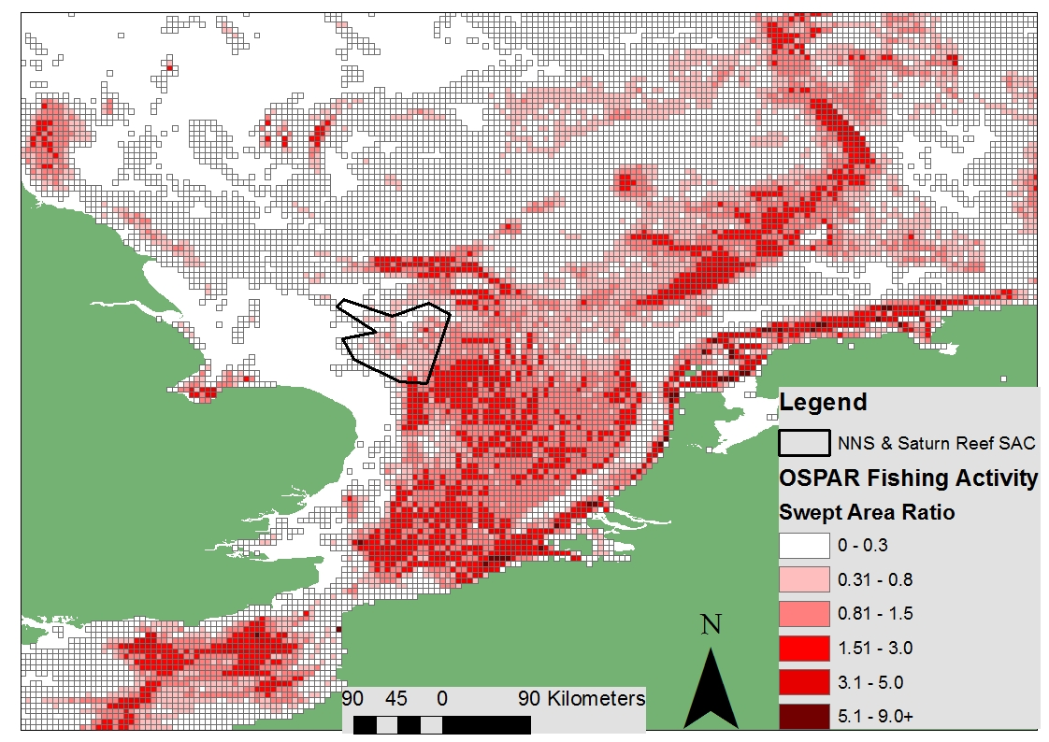
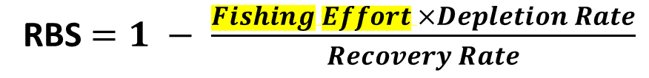
Fishing Effort?
Fishing Effort = Swept Area Ratio calculation
Swept area based on gear swept-width and tow speeds
Swept Area Ratio = total swept area per grid-cell divided by grid-cell area
RBS $=1 − \frac{Fishing Effort ×Depletion Rate}{Recovery Rate}$
Notes:
The fishing effort part of the model is based on a swept area ratio calculation. Swept area is based on gear swept width and tow speeds. And then the ratio is calculated by total swept area per grid cell divided by grid cell area. An example of swept area ratio of all fishing activity is highlighted here.

Slide 13
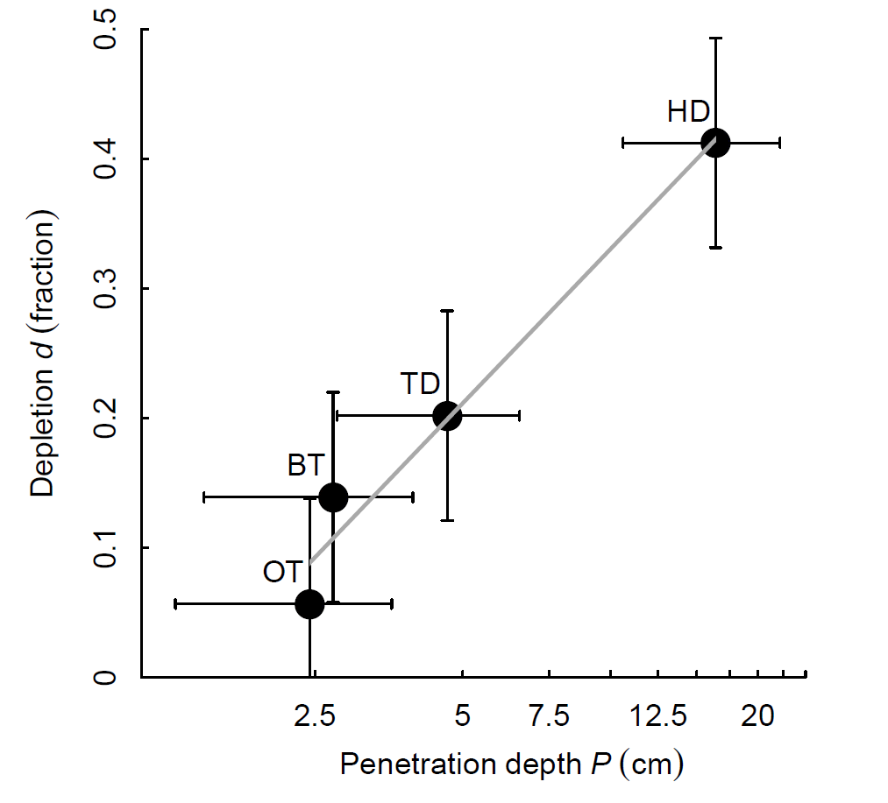
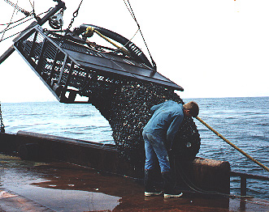
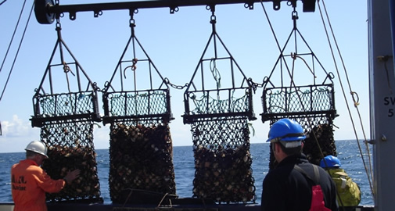
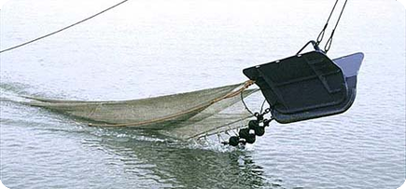
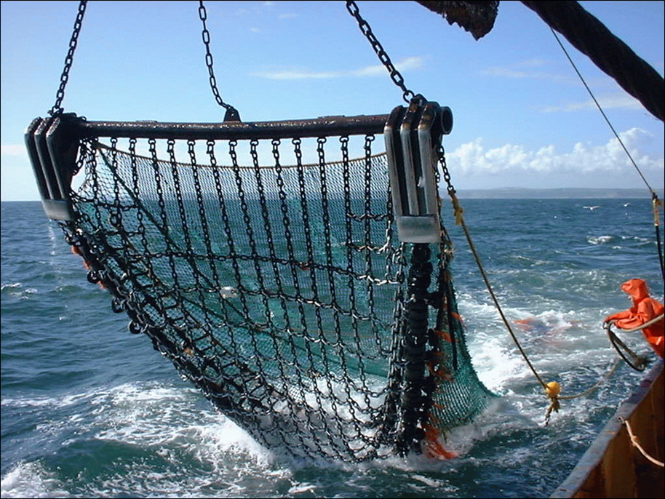

Depletion Rate?
Fraction of organisms killed by a trawl pass = depletion
Depletion is gear specific
i.e. different gears have different effects on the seabed
Hiddink et al., 2017 (paper 2)
HD = hydraulic dredge
TD = towed dredge
BT = beam trawl
OT = otter trawl
RBS $=1 − \frac{Fishing Effort ×Depletion Rate}{Recovery Rate}$
Notes:
The depletion rate is based on another study by Hiddink and colleagues and this relates to the fraction of organisms killed by a trawl pass. The depletion is gear specific, that is, different gears have different effects on the seabed. For example hydraulic dredges have a higher depletion rate as they penetrate deeper into the seabed. We have all the mean values for these gears already from this analysis.

Slide 14
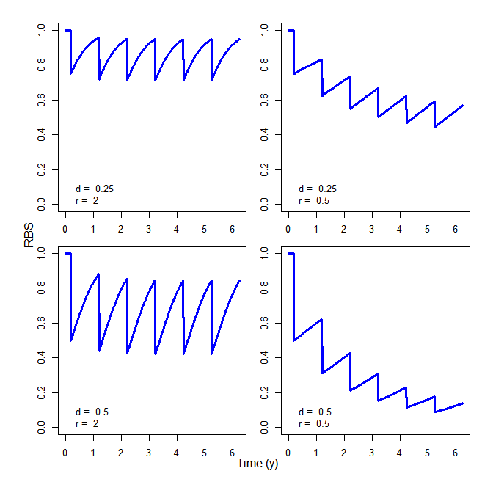

Fast recovery
Slow recovery
So in simple terms… RBS model uses the ratio between depletion and recovery
Low trawl mortality
High trawl mortality
RBS $=1 − \frac{Fishing Effort ×Depletion Rate}{Recovery Rate}$
Notes:
Simply put, the RBS model uses the ratio between depletion and recovery. This is highlighted in these plots, Here we have fast recovery after depletion, so low trawl mortality, whilst here we have slow recovery after depletion and high trawl mortality.

Slide 15
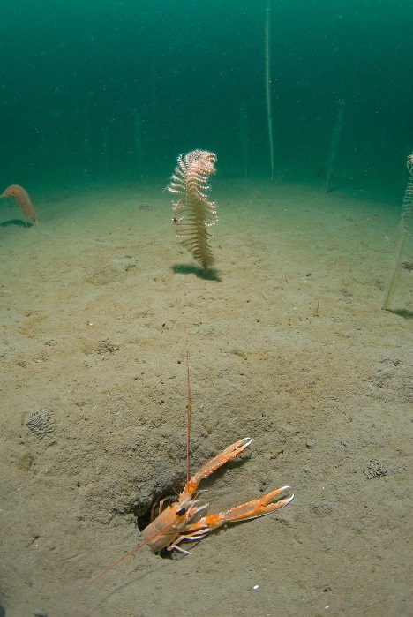
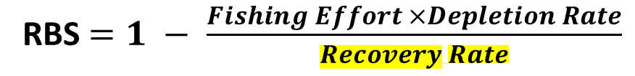
Recovery Rate?
Photo credit: Paul Naylor, Wildlife Trusts
Rate of population recovery is…
species and habitat specific
We can use species longevity to define recovery…
Hiddink et al., 2018 (paper 3)
RBS $=1 − \frac{Fishing Effort ×Depletion Rate}{Recovery Rate}$
Notes:
The recovery rate details how fast a population can recover after disturbance. The rate of population recovery is species and habitat specific. Hiddink and colleagues in 2018 used species longevity to define recovery.

Slide 16
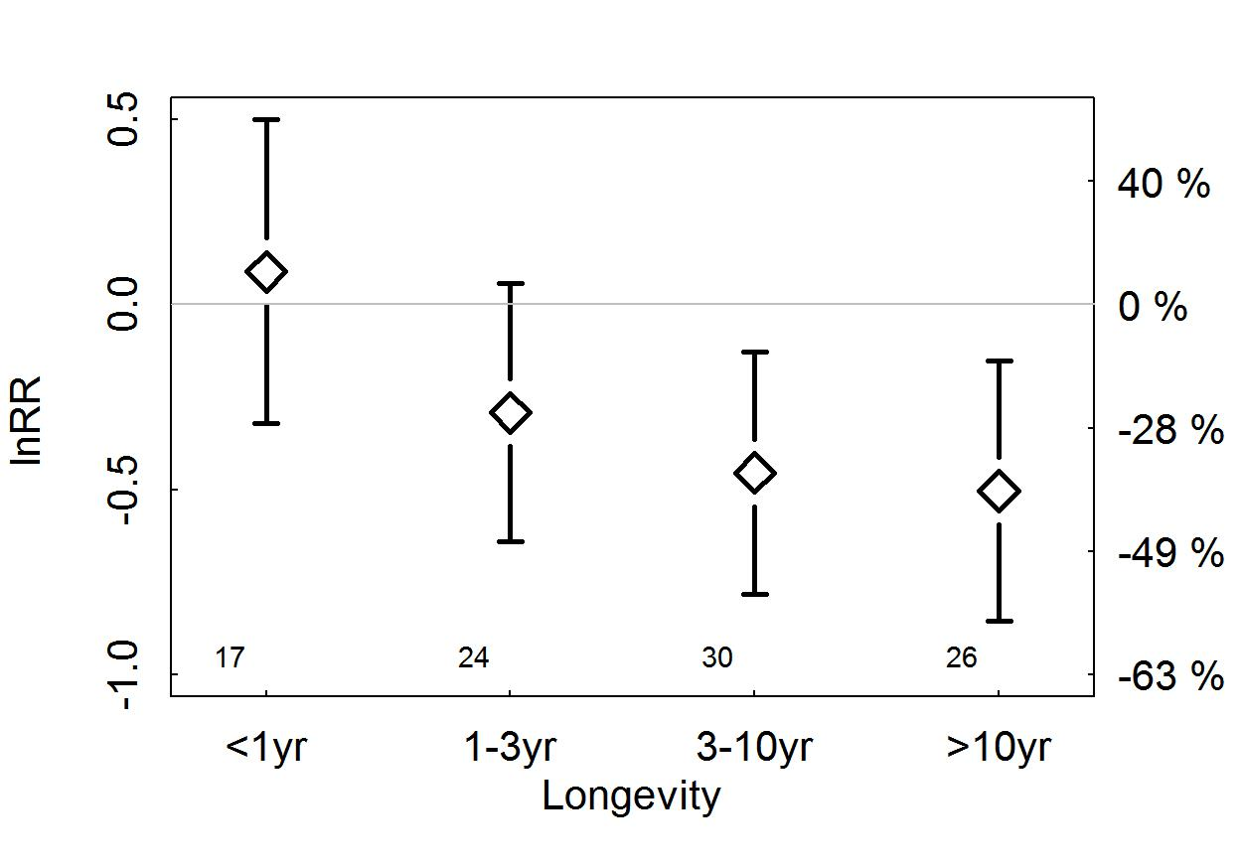
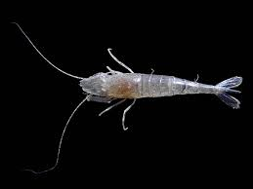
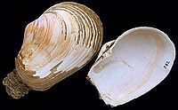
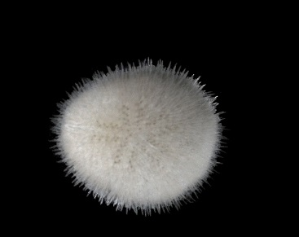
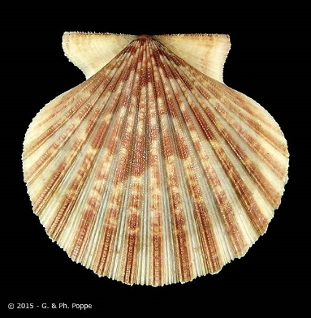
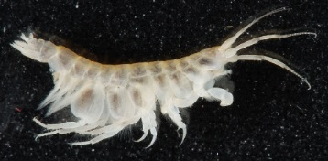
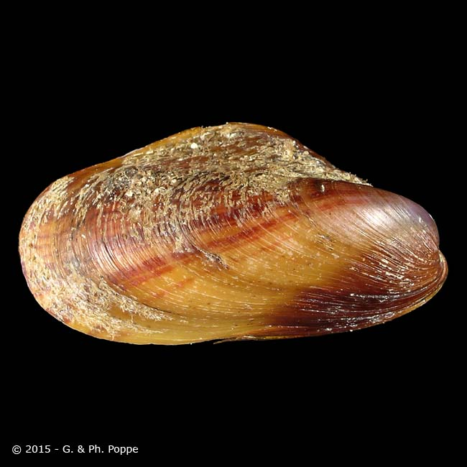
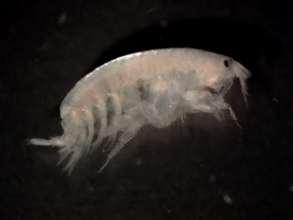
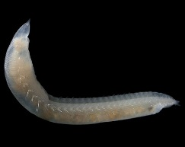
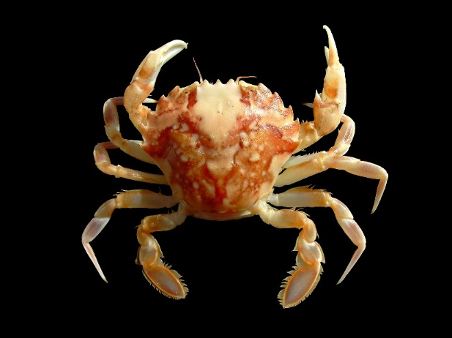
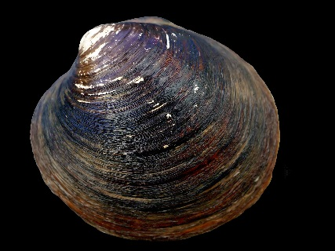
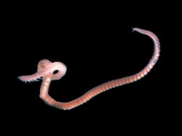
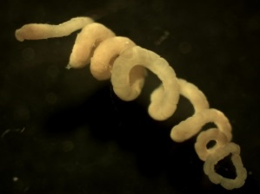
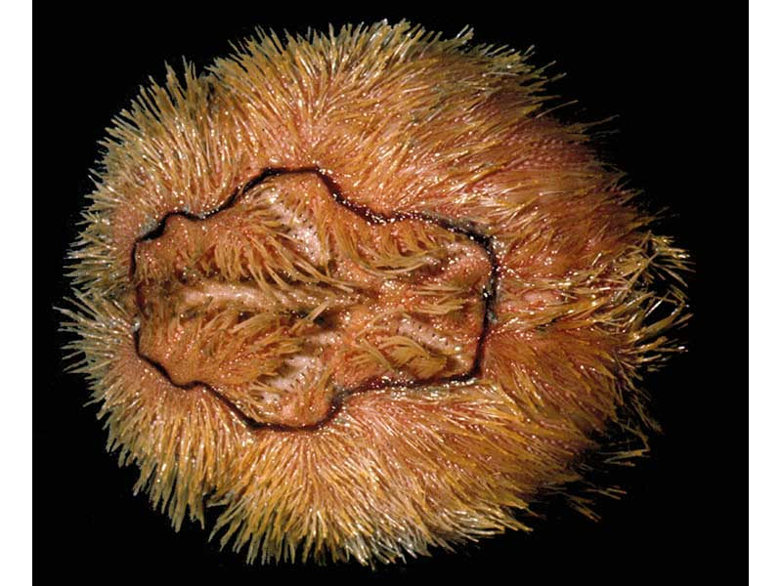
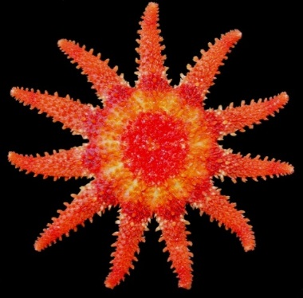
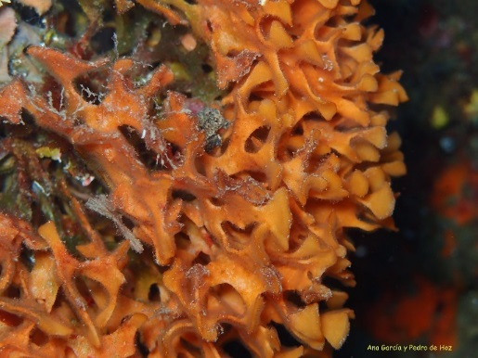
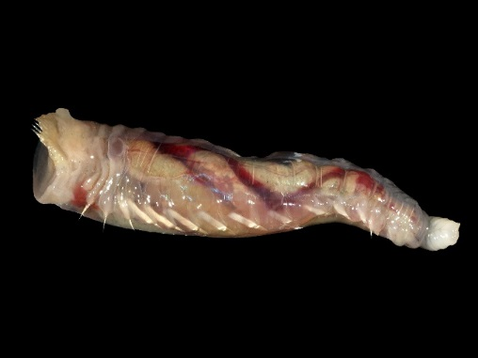
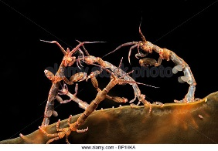
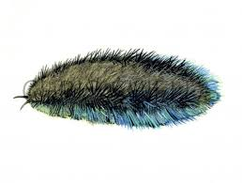
Quantify sensitivity (recovery time) by longevity
Notes:
In any habitat there will be a range of organisms with different longevities – long lived species will recover much more slowly than short lived species. We can use this to predict recovery rates

Slide 17
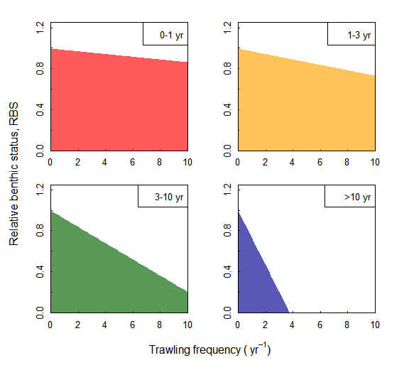
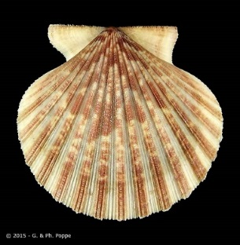
Different slopes for longevities
Notes:
So for example, if we have a benthic community made up of short lived species that recover quickly, it would be able to survive higher trawling frequencies because they can recover more quickly in between trawling events. If, however, we have a community of long lived species, these would not be able to survive very high trawling frequencies because they would not have time to recover in between trawling events.

Slide 18
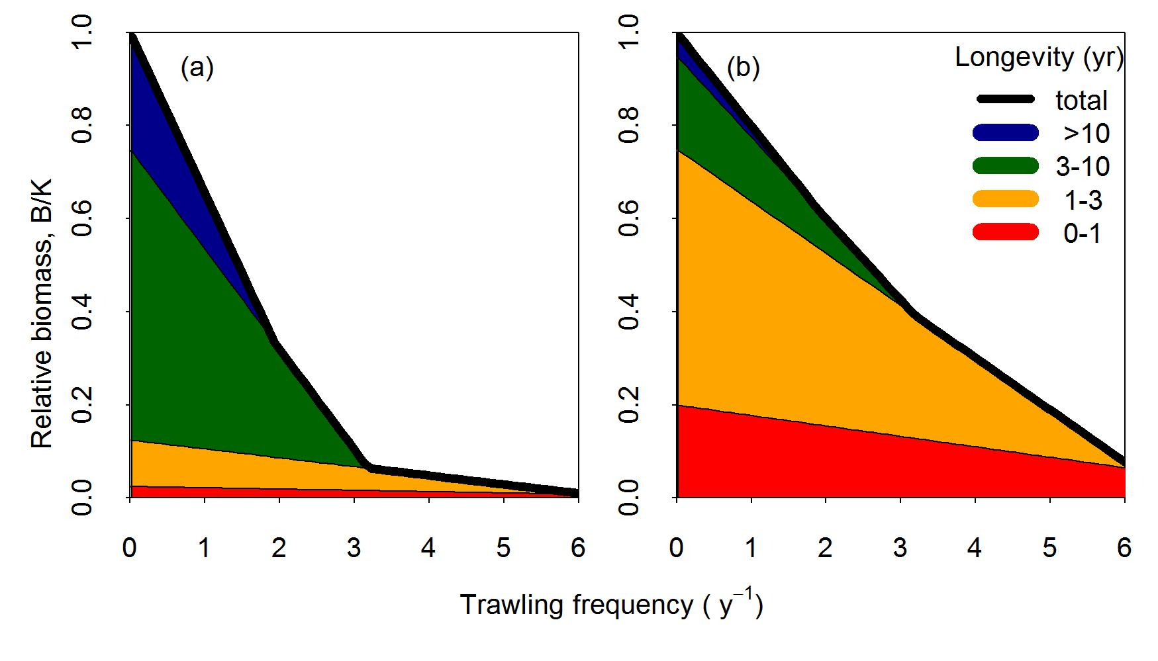
Example of sensitive and resilient communities
sensitive
resilient
Notes:
So if you imagine, we may have a sensitive community that is made up of a large proportion of longer lived species – the long lived slower recovering species would be quicker to disappear at lower trawling intensities and overall community biomass would decrease. If we have a more resilient community that is made up mainly of short lived fast growing species, the community as a whole would be more resilient to higher frequencies of trawling.
So, if we know something about the community composition of a habitat, we can better predict how it will be impacted by trawling.

Slide 19
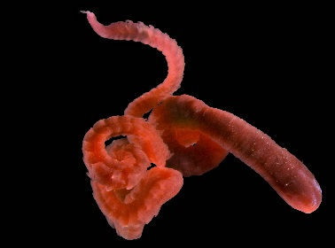
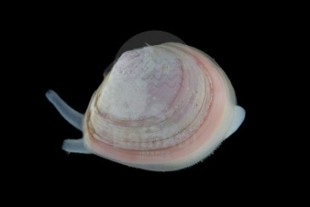
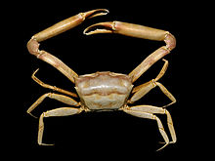

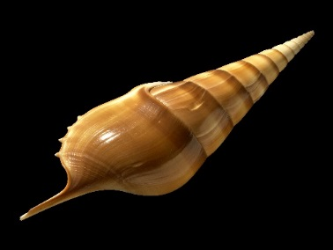
Longevity distribution by habitat
Relative biomass
Longevity (yr)
Rijnsdorp et al., 2018 (paper 4)
Notes:
In this study by Adriaan Rijnsdorp they were able to model the longevity distribution – so the fraction of animals in each longevity class – per habitat. So, you can see that mud habitats are dominated by short lived fast growing species, whereas coarse gravelly habitats have a higher proportion of longer lived species so the community would be more sensitive to trawling.

Slide 20
How can we apply this approach?
Notes:
So, how can we apply this approach?

Slide 21

Maps of where fishing takes place
What is the current status of each habitat type?
[Relative Benthic Status - RBS]
Maps of habitat type
Information on depletion by gear type
Recovery rates [proportion of animals in each longevity class]
RBS $=1 − \frac{Fishing Effort ×Depletion Rate}{Recovery Rate}$
Notes:
The Relative Benthic Status asks, what is the current status of each habitat type? To answer this question from this project’s perspective, we need: maps of where fishing takes place, maps of habitat type, information on depletion by gear type and community recovery rates.

Slide 22
Relative Benthic Status
Example output for NW Europe from ICES
Proportion of biomass remaining relative to an un-impacted baseline
RBS 1 = No depletion
RBS 0 = Complete depletion
RBS 0.6 = 60% of possible biomass remaining
Notes:
The relative benthic status model output is a score from 0 to 1, which highlights the proportion of biomass remaining, relative to an un-impacted baseline. RBS of 1 is no depletion. RBS of 0 is complete depletion. RBS of 0.6 is 60% of possible biomass remaining.

Slide 23
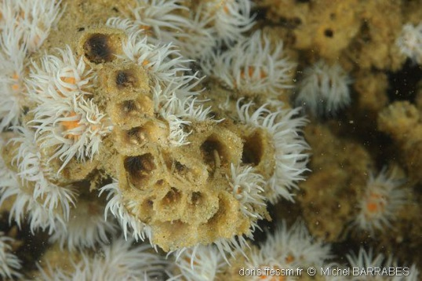
Baselines
RBS gives an idea of whether the seabed is in a good state or not, relative to an un-impacted baseline
If little is known about the species in a given habitat, then we can also work with a single species… the longest lived species
e.g. the Sabellaria sp. at the NNS and S site
<9 year life span
Notes:
The RBS score gives us an idea of whether a seabed is in a good state or not, relative to an unimpacted baseline. If little is known about the species in a given habitat, then we can also work with a single species… the longest lived species. For example, the sea pen at the West of Walney Site.

Slide 24
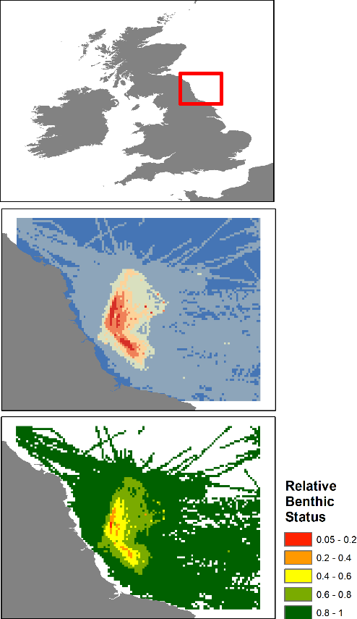

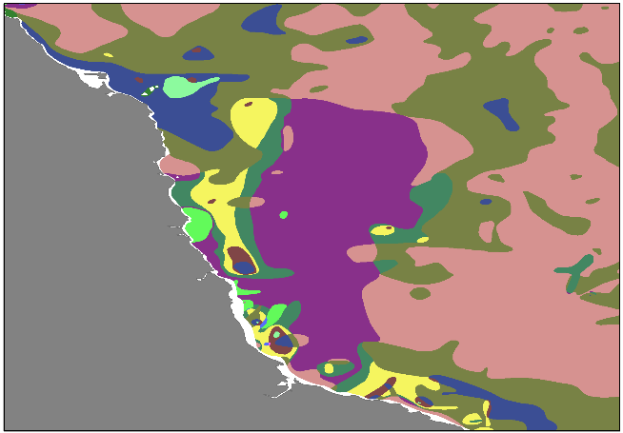
Example Data Layers
Map of fishing activity
Map of habitats
Notes:
So, I’ll just quickly run through an example. Here we have a map of fishing activity and a map of habitats in the same area.

Slide 25
Example Data Layers
Depletion rates of fishing gears
Map of fishing activity
Fraction of animals in each longevity class in each habitat
Map of habitats
Notes:
Alongside these, we include the depletion rates of fishing gears and the fraction of animals in each longevity class in each habitat.

Slide 26
Example Data Layers
Depletion rates of fishing gears
Map of fishing activity
Fraction of animals in each longevity class in each habitat
Map of habitats
Notes:
This gives us the Relative Benthic Status of that area. As we can see The RBS is low (in red) in the middle.

Slide 27


Example Data Layers
RBS score per habitat type
Mean RBS = 0.93
Muddy Sand
Notes:
From this we can determine the mean relative benthic status per habitat type and also determine the number of years it would take to return to an undisturbed baselin, if left undisturbed.

Slide 28
Limitations
It is a model, only as good as simplifications & assumptions
Response variable: relative community biomass.
Correlates with biodiversity, ecosystem functioning.
Bounds of usability
Sedimentary habitats
Towed bottom gears
Recruitment and dispersal not included
Notes:
There are some limitations to this approach – ultimately it is a model, so it is only as good as its simplifications and assumptions
In particular, the response variable is relative community biomass – so this means, the current biomass relative to an unimpacted baseline – this does correlate with biodiversity and ecosystem functioning – but we’re not talking about absolute biomass.
The model is limited to sedimentary habitats and towed bottom gears – this is driven by the available evidence. The studies included in the meta-analysis only included towed bottom gears, and habitats were quantified based on sediments, so mud sand and gravel.
And finally, recruitment and dispersal are not included in the model. Recovery is only modelled from the biomass remaining in an area after trawling, and doesn’t include the potential contribution from recruitment and immigration to an area.

Slide 29

Conclusions
Simple approach based on latest science
Combines theory with most robust available parameter estimates
Low demand for data layers
RBS $=1 − \frac{Fishing Effort ×Depletion Rate}{Recovery Rate}$
Notes:
Despite the limitations, this provides a simple approach to quantifying the imapcts of trawling which is based on the latest science and the most comprehensive review of all trawling impact studies conducted globally. So we have the most robust available parameter estimates for depletion and recovery following trawling.
Because this is a relatively simple approach, it means that there is relatively low demand for data – to apply this approach we just need to know where fishing takes place and over what habitats – which means it is an accessible approach to quantifying the imacts of trawling.

Slide 30



Acknowledgements BENTHIS and Trawling Best Practices Rijnsdorp, Jennings, Kaiser, Pitcher, Hilborn, Bolam and others
The work was funded by FP7 project BENTHIS (312088), DEFRA, NERC, Packard Foundation, Walton Foundation, American Seafoods Group U.S., Blumar Seafoods Denmark, Espersen Group, Glacier Fish Company LLC U.S., Independent Fisheries Limited N.Z., Nippon Suisan (USA), Inc., Pacific Andes International Holdings, Ltd., San Arawa, S.A., Sanford Ltd. N.Z., Sealord Group Ltd. N.Z., South African Trawling Association
@Macomabalthica
Notes:
So this work is based on research outputs from the BENTHIS and Trawling Best Practices Projects

Slide 31
Based on peer-reviewed science Approach used by ICES and MSC
Hiddink, J.G., Jennings, S., Sciberras, M., Bolam, S.G., Cambiè, G., McConnaughey, R.A., Mazor, T., Hilborn, R., Collie, J.S., Pitcher, R., Parma, A.M., Suuronen, P., Kaiser, M.J. & Rijnsdorp, A.D. (In press) Assessing bottom-trawling impacts based on the longevity of benthic invertebrates. Journal of Applied Ecology
Hiddink, J.G., Jennings, S., Sciberras, M., Szostek, C.L., Hughes, K.M., Ellis, N., Rijnsdorp, A.D., McConnaughey, R.A., Mazor, T., Hilborn, R., Collie, J.S., Pitcher, R., Amoroso, R.O., Parma, A.M., Suuronen, P. & Kaiser, M.J. (2017) Global analysis of depletion and recovery of seabed biota following bottom trawling disturbance. Proceedings of the National Academy of Sciences, 114, 8301–8306.
Pitcher, C.R., Ellis, N., Jennings, S., Hiddink, J.G., Mazor, T., Kaiser, M.J., Kangas, M.I., McConnaughey, R.A., Parma, A.M., Rijnsdorp, A.D., Suuronen, P., Collie, J.S., Amoroso, R., Hughes, K.M. & Hilborn, R. (2017) Estimating the sustainability of towed fishing-gear impacts on seabed habitats: a simple quantitative risk assessment method applicable to data-limited fisheries. Methods in Ecology and Evolution, 8, 472-480.
Rijnsdorp, A.D., Bolam, S.G., Garcia, C., Hiddink, J.G., Hintzen, N., Kooten, T.v. & Denderen, P.D.v. (2018) Estimating the sensitivity seafloor habitats to disturbance by bottom trawling impacts based on the longevity of benthic fauna. Ecological Applications, 28, 1302-1312.
Sciberras, M., Hiddink, J.G., Jennings, S., Szostek, C.L., Hughes, K.M., Kneafsey, B., Clarke, L.J., Ellis, N., Rijnsdorp, A.D., McConnaughey, R.A., Hilborn, R., Collie, J.S., Pitcher, C.R., Amoroso, R.O., Parma, A.M., Suuronen, P. & Kaiser, M.J. (2018) Response of benthic fauna to experimental bottom fishing: a global meta-analysis. Fish and Fisheries, 19, 698-715.
https://trawlingpractices.wordpress.com/
Notes:
And here we have some links to the peer-reviewed science behind the model – which is currently being implemented by both ICES and the Marine Stewardship Council.

Slide 32
Q & A

Slide 33
First from last meeting:
We would like more of an overview about what studies the model is based on.
Clarity about its limitations.
What is the function of the model within the project?
What is being used as a baseline – are we hoping to help a site recover, or starting from present status – what data will be inputted?
Species richness as well as biomass?
How much confidence can we have?

Slide 34

Need to consider displacement, the model could show this in action (scenario session)
Model is guidance but will only take us so far. Need monitoring of feature condition to back this up. (yes)
The scale is a limitation - it treats trawls and sediments as the same. (not necessarily true… depletion slide)
It doesn’t encompass all species. (might longest lived species be enough?)
Low confidence in the model as there’s so much variation in habitat and gear type (model is an aid, not the final answer)
The more site specific it is the better (definitely)
Model should aim to consider what should be there, not just what is there. (who are we to say what ‘should’ be there? Life is constantly changing)

Slide 35
Smaller vessels don’t have VMS – then missing 60% of boats (is this a big problem for working with MPAs? If so, is it quantifiable?) Scenario session later will highlight this problem!
Recruitment both larval and local density driven; re-colonisation is complex and difficult to include in the model (do not account for recruitment in model)
Does the interpretation of models need to done by the person who built it? (interpretation of model output can be done by anyone – manuals will be provided and we need to discuss what you want the model output to tell you in management terms)

Slide 36

Confidence in model?
This model has been peer-reviewed by top scientists in fisheries science
We’re currently testing confidence in model
(outputs available within 1.5 years)
Sensitivity analysis: involves degenerating the model inputs (fishing and habitat data) to determine if model output is degenerated or largely the same
Testing the model with different fisheries at a global scale
a) Site-specific data will be used per MPA
b) Gear-specific data will be used per fishery, where available
c) Benefit of model: can work with data for longest lived species
e.g. pink sea fan

